Slide 1
SEPM – Unit V
Week 5 - Schedule
Basics of software maintenance
Changing a Software System
Lehman Laws for software maintenance and evolution of large systems
Legacy Systems
Software Maintenance Prediction
Components of Software Maintenance Framework
Maintenance Cost

Slide 2
Basics of software maintenance
Software Maintenance is the process of modifying a software product after it has been delivered to the customer.
The main purpose of software maintenance is to modify and update software application after delivery to correct faults and to improve performance.

Slide 3
Basics of software maintenance
Need for Maintenance :-
Software Maintenance must be performed in order to:
Correct faults.
Improve the design.
Implement enhancements.
Interface with other systems.
Accommodate programs so that different hardware, software, system features, and telecommunications facilities can be used.
Migrate legacy software (old and outdated program).
Retire software.

Slide 4
Basics of software maintenance
Categories of Software Maintenance:– Maintenance can be divided into the following:
Corrective maintenance: rectify some bugs observed while the system is in use.
Adaptive maintenance: modifications and updations when the customers need the product to run on new platforms, on new OS.
Perfective maintenance: to support the new features that the users want
Preventive maintenance: includes modifications and updations to prevent future problems of the software.

Slide 5
Changing a Software System
The changes may be simple changes to correct coding errors,
more extensive changes to correct design errors or
significant enhancements to correct specification errors or
accommodate new requirements.

Slide 6
Changing a Software System
Software change is inevitable :–
New requirements emerge when the software is used
The business environment changes
Errors must be repaired
New equipment must be accommodated
The performance or reliability may have to be improved
A key problem for organizations is implementing and managing change to their legacy systems • Project
– A change to your project
– A change to someone else’s project
• Another team in your class
• Another team from 2000
• Another team from 1990

Slide 7
Lehman Laws for software maintenance and evolution of large systems
The laws of software evolution refer to a series of laws
that Lehman and Belady formulated starting in 1974 with respect to software evolution.
The laws describe a balance between forces driving new developments on one hand, and forces that slow down progress on the other hand.
Over the past decades the laws have been revised and extended several times

Slide 8
Lehman Laws for software maintenance and evolution of large systems
Lehman qualified the application of such laws by distinguishing between three categories of software:
An S-program is written according to an exact specification of what that program can do
A P-program is written to implement certain procedures that completely determine what the program can
An E-program is written to perform some real-world activity; how it should behave is strongly linked to the environment in which it runs, and such a program needs to adapt to varying requirements and circumstances in that environment

Slide 9
Lehman Laws for software maintenance and evolution of large systems
The laws :- Eight laws were formulated:
(1974) "Continuing Change" - E-type system
(1974) "Increasing Complexity" - E-type system
(1974) "Self Regulation“- E-type system
(1978) "Conservation of Organisational Stability (invariant work rate)" - E-type system
(1978) "Conservation of Familiarity“- E-type system
(1991) "Continuing Growth" - E-type system
(1996) "Declining Quality" - E-type system
(1996) "Feedback System“- E-type evolution constitute multi-level, multi-loop, multi-agent system.

Slide 10
Legacy Systems
A legacy system is an old method, technology, computer system, or application program, "of, relating to, or being a previous or out dated computer system," yet still in use.
Often referencing a system as "legacy" means that it paved the way for the standards that would follow it.
This can also imply that the system is out of date or in need of replacement.
Examples include hardware in power plants, manufacturing machines controlled by computers running MS-DOS, or outdated financial systems

Slide 11
Legacy Systems
Organizations can have compelling reasons for keeping a legacy system, such as:
The system works satisfactorily, and the owner sees no reason to change it.
The costs of redesigning or replacing the system are prohibitive because it is large, monolithic, and/or complex.
Retraining on a new system would be costly in lost time and money, compared to the anticipated appreciable benefits of replacing it
The system requires near-constant availability, so it cannot be taken out of service, and the cost of designing a new system.

Slide 12
Legacy Systems
The way that the system works is not well understood. Such a situation can occur when the designers of the system have left the organization.
The user expects that the system can easily be replaced when this becomes necessary.
Newer systems perform undesirable secondary functions such as a) tracking and reporting of user activity and/or b) automatic updating that creates "back-door" security vulnerabilities and leaves end users dependent on the good faith and honesty of the vendor providing the updates.

Slide 13
Software Maintenance Prediction
Software maintenance prediction refers to the study of software maintainability,
the modifications in the software system, and
the maintenance costs that are required to maintain the software system.
Various maintenance predictions and the questions associated with them.

Slide 14
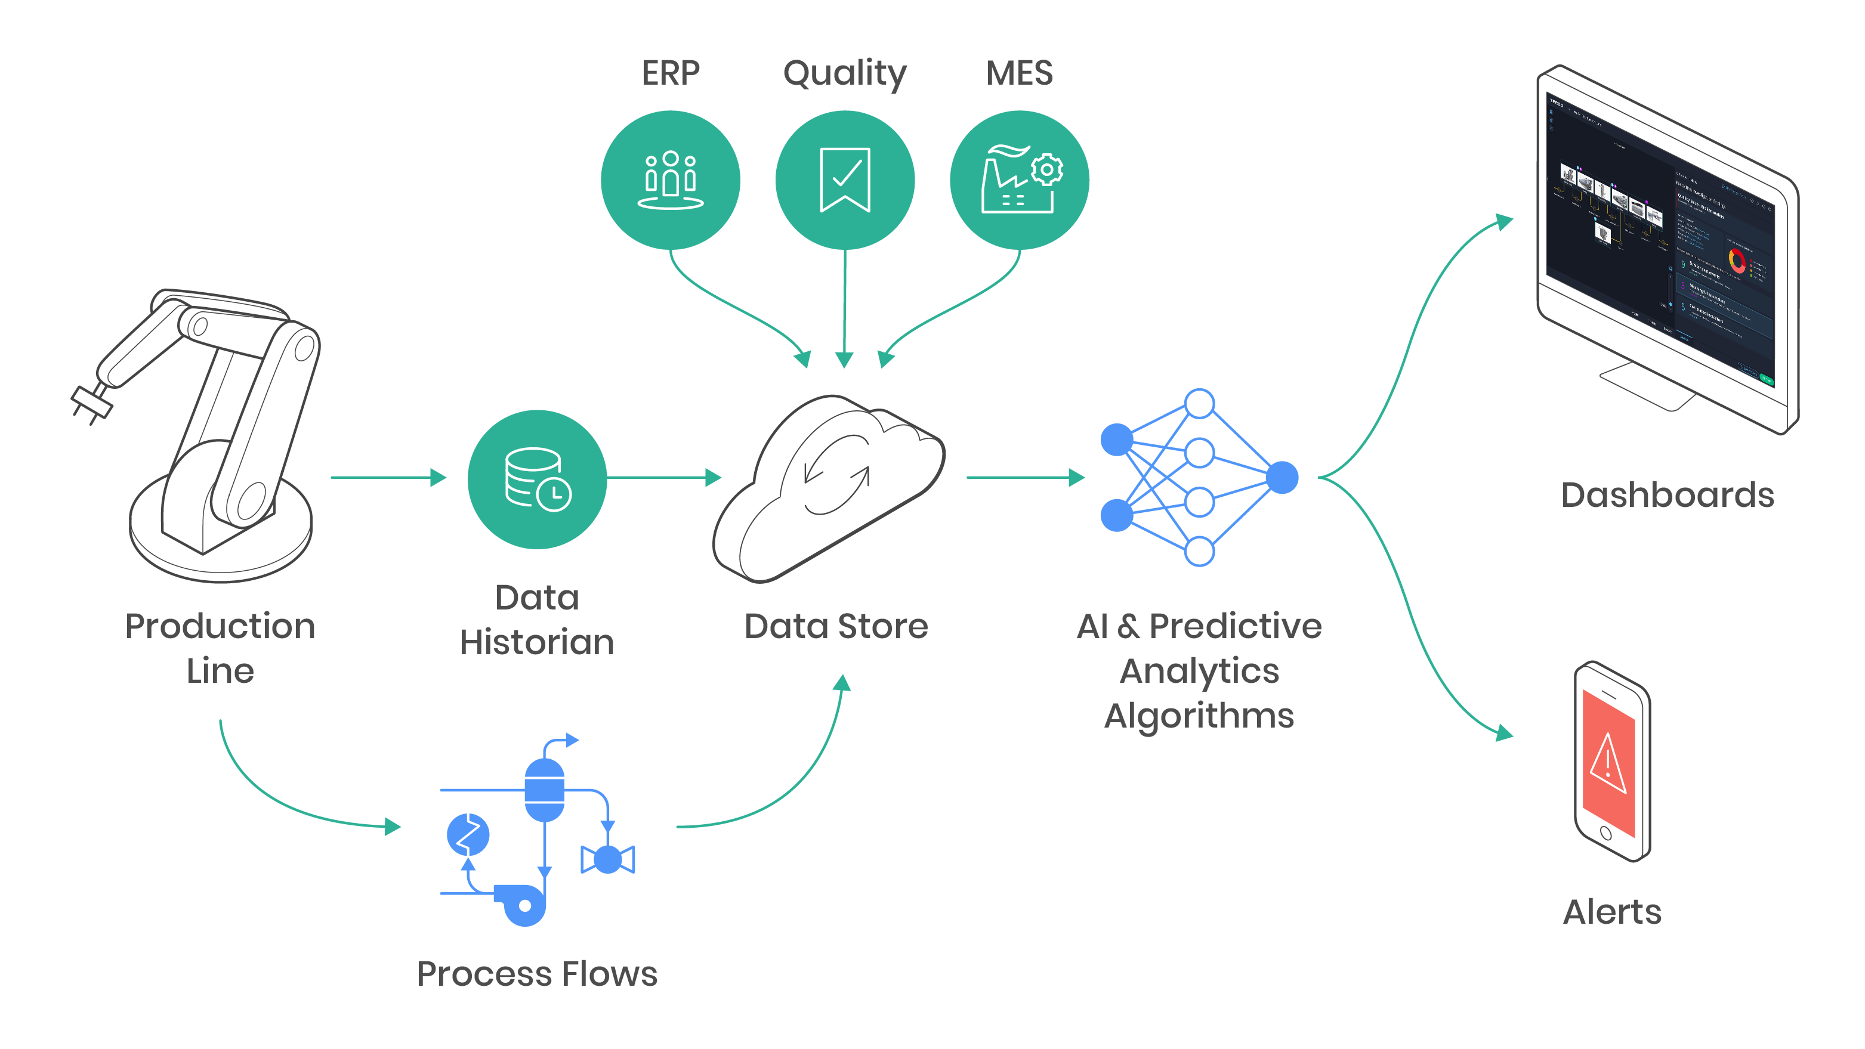
Software Maintenance Prediction
Predictive maintenance architecture

Slide 15
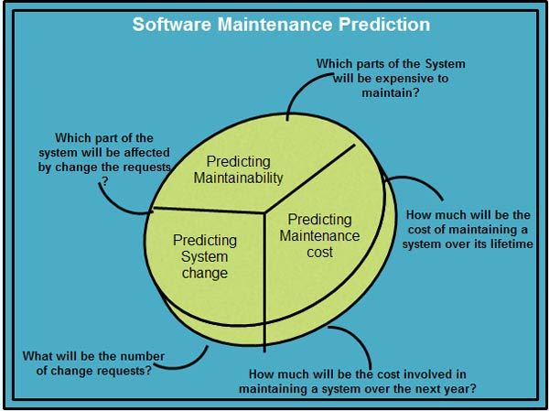
Software Maintenance Prediction

Slide 16
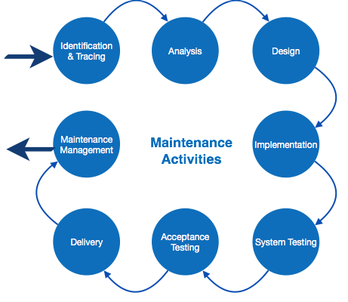
Components of Software Maintenance Framework
IEEE provides a framework for sequential maintenance process activities.
It can be used in iterative manner and can be extended so that customized items and processes can be included.

Slide 17
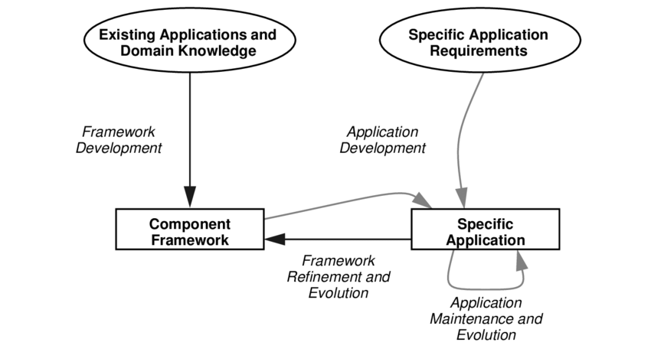
Components of Software Maintenance Framework
A Component-Oriented Software Lifecycle

Slide 18
Maintenance Cost
Software maintenance cost is derived from the changes made to software after it has been delivered to the end user.
Perfective maintenance – costs due to improving or enhancing a software solution to improve overall performance (generally 5% of software maintenance costs)
Cost of Maintenance:
Reports suggest that the cost of maintenance is high.
A study on estimating software maintenance found that the cost of maintenance is as high as 67% of the cost of entire software process cycle.

Slide 19
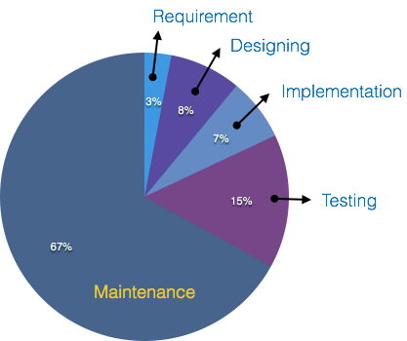
Maintenance Cost
Cost of Maintenance:

Slide 20
Maintenance Cost
Real-world factors affecting Maintenance Cost
The standard age of any software is considered up to 10 to 15 years.
Older softwares, which were meant to work on slow machines with less memory and storage capacity cannot keep themselves challenging against newly coming enhanced softwares on modern hardware.
As technology advances, it becomes costly to maintain old software.
Most maintenance engineers are newbie and use trial and error method to rectify problem.

Slide 21
Maintenance Cost
Real-world factors affecting Maintenance Cost
Often, changes made can easily hurt the original structure of the software, making it hard for any subsequent changes.
Changes are often left undocumented which may cause more conflicts in future.
Software-end factors affecting Maintenance Cost
Structure of Software Program
Programming Language
Dependence on external environment
Staff reliability and availability

